Slide 1

7th Grade Math
Unit 5, Lesson 5 Scale Factors – Perimeter Volume 1, pg. 203

Slide 2


Benchmark
MA.7.GR.1.5
Solve mathematical and real-world problems involving dimensions and areas of geometric figures, including scale drawings and scale factors.
volume 1, pg. 203

Slide 3
Integrated Mathematical Thinking and Reasoning Standards
MA.K12.MTR.5.1 Use patterns and structure to help understand and connect mathematical concepts.
MA.K12.MTR.6.1 Assess the reasonableness of solutions.
volume 1, pg. 203

Slide 4

Learning Target
I can relate the perimeters of rectangles to their scale factors.
volume 1, pg. 203

Slide 5

Warm-Up
volume 1, pg. 203

Slide 6
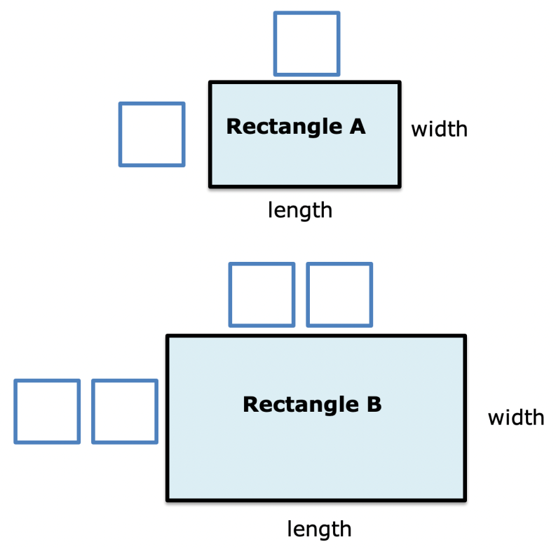
5.5.1 Warm-Up: Scaled Copies
Two rectangles are shown with their dimensions missing.
volume 1, pg. 203
Notes:
Video Link: https://algebranation.wistia.com/medias/fi4fidi5y8

Slide 7
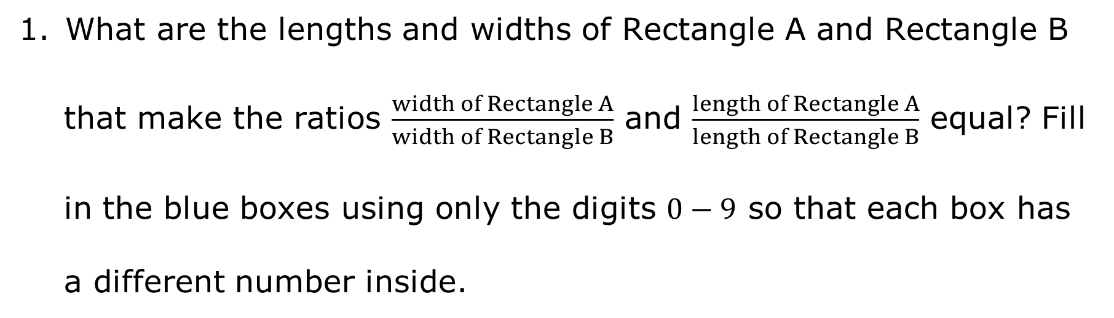
What are the lengths and widths of Rectangle A and Rectangle B
that make the ratios $\frac{width of Rectangle A}{width of Rectangle B}$ and $\frac{length of Rectangle A}{length of Rectangle B}$ equal? Fill in the blue boxes using only the digits $0−9$ so that each box has a different number inside.
volume 1, pg. 203
Notes:
Video Link: https://algebranation.wistia.com/medias/fi4fidi5y8

Slide 8

Guided Instruction
volume 1, pg. 204

Slide 9

5.5.2 Guided Instruction: Scale Drawings and Scale Factors
In the warm-up, the ratio of the widths of rectangles 𝐴 and 𝐵 is equivalent to the ratio of the lengths of rectangles 𝐴 and 𝐵. Therefore, rectangle 𝐴 is a scale model of rectangle 𝐵.
A scale model is a model or drawing based on a ratio of the dimensions for the model and the actual object it represents.
volume 1, pg. 204

Slide 10
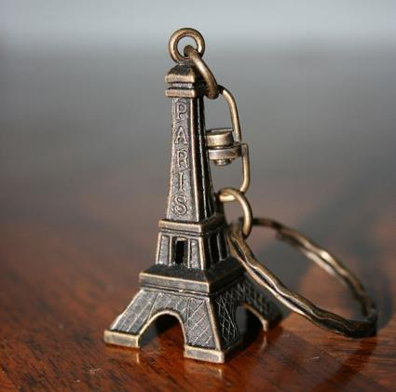
The keychain shown of the Eiffel Tower is a scale model of the real Eiffel Tower in Paris.
Sketch a drawing of the Eiffel Tower that is not a scale model.
Discuss with your partner why your drawing is not a scale model. Write a summary of your discussion.
volume 1, pg. 204

Slide 11
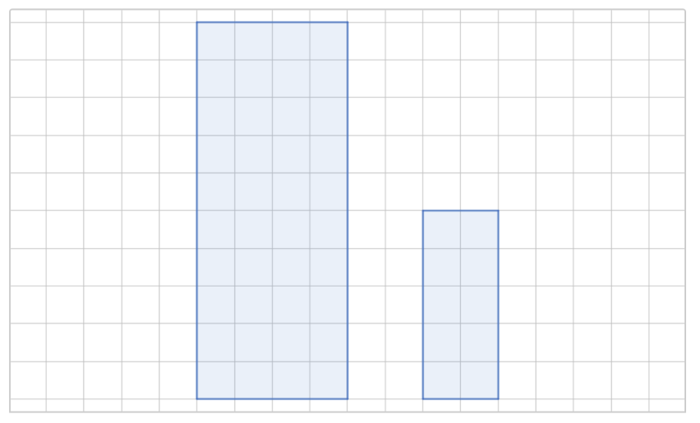
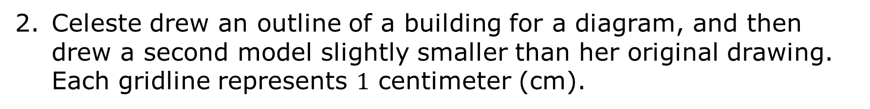
Celeste drew an outline of a building for a diagram, and then drew a second model slightly smaller than her original drawing. Each gridline represents $1$ centimeter (cm).
Figure A
width
Figure B
width
length
length
volume 1, pg. 204

Slide 12
The length of Figure A and the length of Figure B can be written as a ratio because they are corresponding parts. This is also true for the widths of the figures.
Corresponding parts are parts of each figure that are in the same position in relation to the rest of each figure.
volume 1, pg. 204

Slide 13
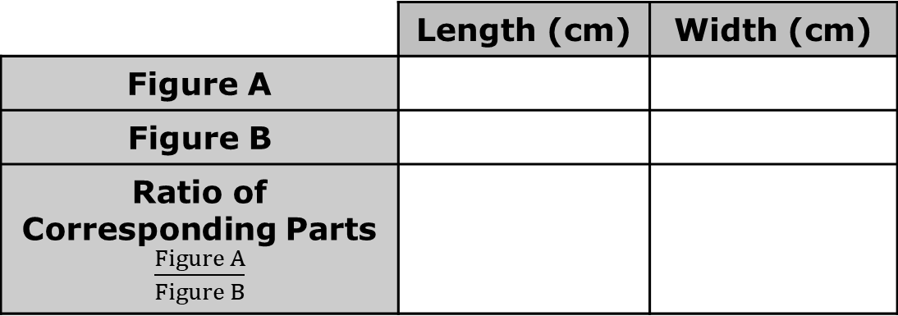
Complete the table for Figures A and B. Each gridline represents $1$ cm.
 | Length (cm) | Width (cm)
Figure A
Figure B
Ratio of Corresponding Parts $\frac{Figure A}{Figure B}$
volume 1, pg. 204

Slide 14
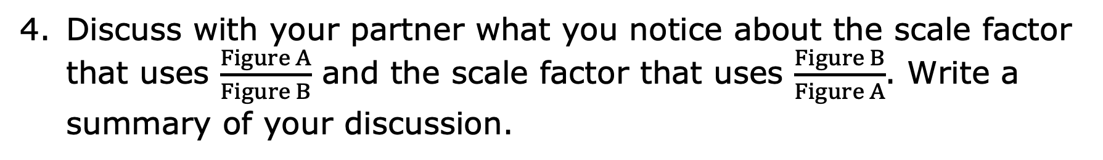
A model is a scale model if the ratios of the corresponding parts of the figures are equivalent. These ratios can be used to determine the scale factor that relates the figures.
A scale factor is the constant that is multiplied by the length of each side of a figure to produce an image that is the same shape as the original figure.
Discuss with your partner what you notice about the scale factor that uses $\frac{Figure A}{Figure B}$ and the scale factor that uses $\frac{Figure B}{Figure A}$. Write a summary of your discussion.
volume 1, pg. 205

Slide 15
Scale models can be scaled up or scaled down.
Scaled Down From the Original | Original | Scaled Up From the Original
volume 1, pg. 205

Slide 16
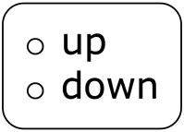
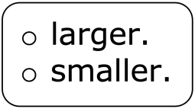
Complete the statements about Figure A and Figure B.
The scale factor that relates Figure A to Figure B is _______ because each side length of Figure A is multiplied by this scale factor to get the side lengths of Figure B.
This is an example of scaling a figure because the figure gets
The scale factor that relates Figure B to Figure A is _____, which is an example of scaling the figure because the figure gets
volume 1, pg. 205

Slide 17

Exploration
volume 1, pg. 206

Slide 18
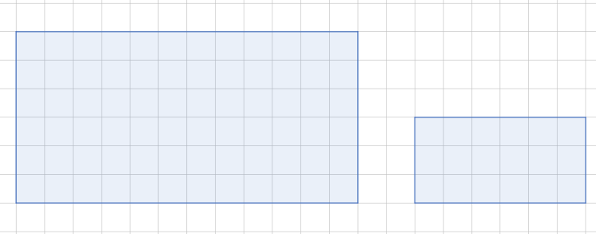

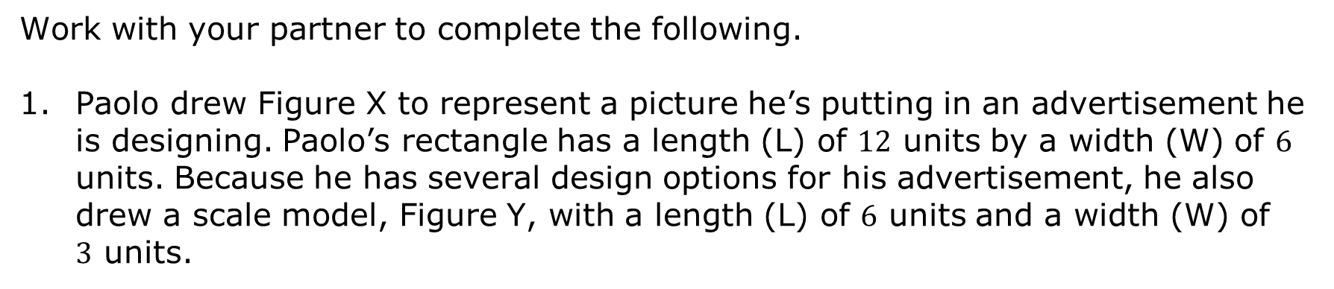



5.5.3 Exploration: Scale Factor and Perimeter
Work with your partner to complete the following.
Paolo drew Figure X to represent a picture he’s putting in an advertisement he is designing. Paolo’s rectangle has a length (L) of $12$ units by a width (W) of $6$ units. Because he has several design options for his advertisement, he also drew a scale model, Figure Y, with a length (L) of $6$ units and a width (W) of $3$ units.
Figure X
W = $6$
Figure Y
W = $3$
L = $12$
L = $6$
volume 1, pg. 206

Slide 19
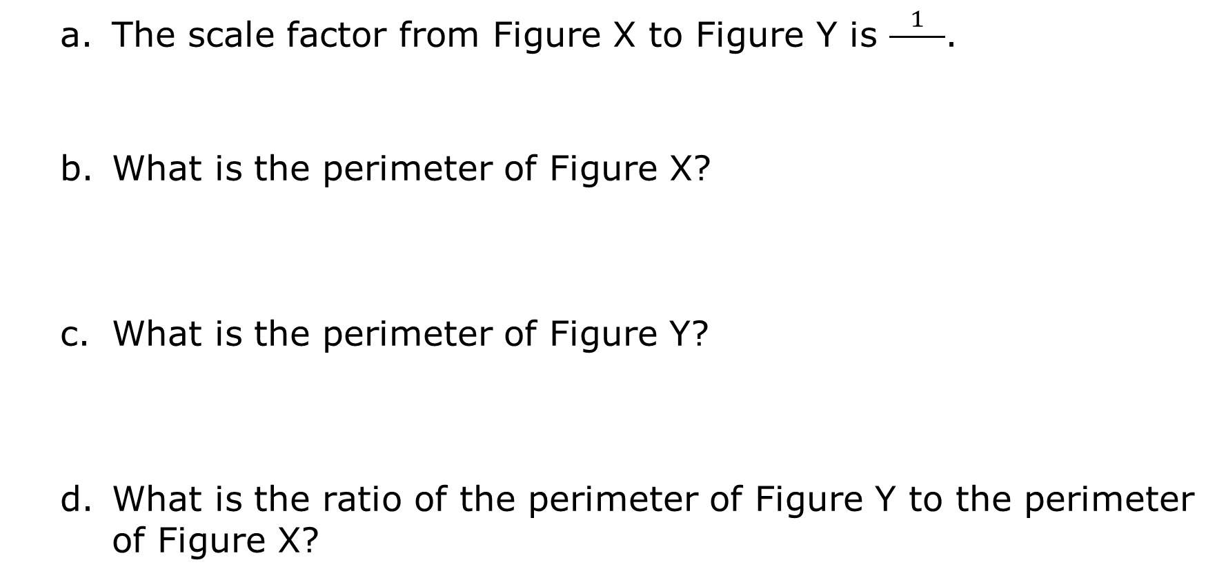
The scale factor from Figure X to Figure Y is $\frac{1}{ }$.
What is the perimeter of Figure X?
What is the perimeter of Figure Y?
What is the ratio of the perimeter of Figure Y to the perimeter of Figure X?
volume 1, pg. 206

Slide 20

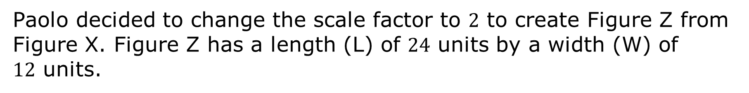


Paolo decided to change the scale factor to $2$ to create Figure Z from Figure X. Figure Z has a length (L) of $24$ units by a width (W) of $12$ units.
Figure Z
W = $12$
L = $24$
volume 1, pg. 206

Slide 21
What is the perimeter of Figure Z?
How does that compare to the perimeter of Figure X?
What relationship, if any, is there between the scale factor and the ratio of the perimeters?
volume 1, pg. 206

Slide 22
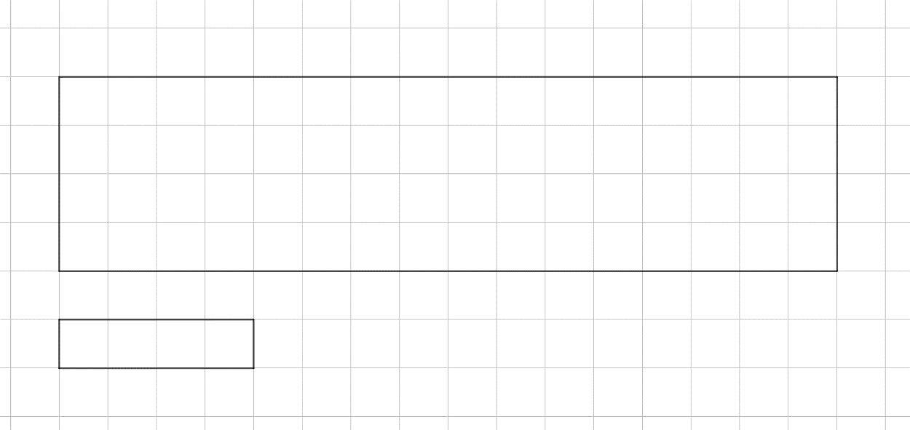

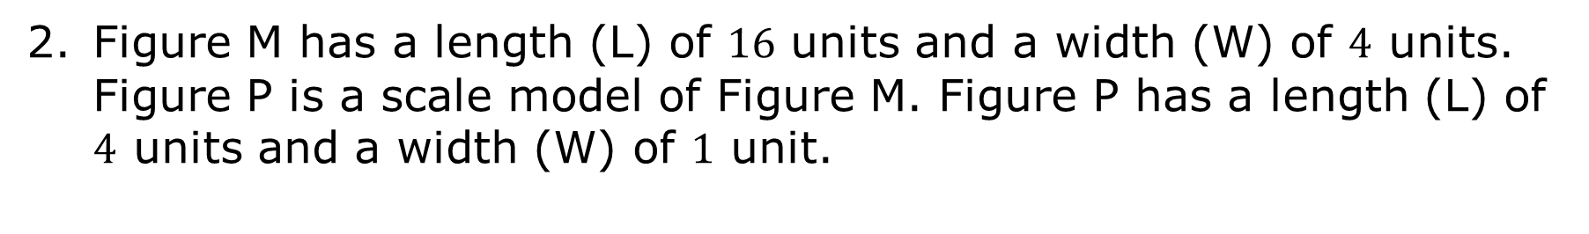



Figure M has a length (L) of $16$ units and a width (W) of $4$ units. Figure P is a scale model of Figure M. Figure P has a length (L) of $4$ units and a width (W) of $1$ unit.
Figure M
W = $4$
Figure P
L = $16$
W = $1$
L = $4$
volume 1, pg. 207

Slide 23
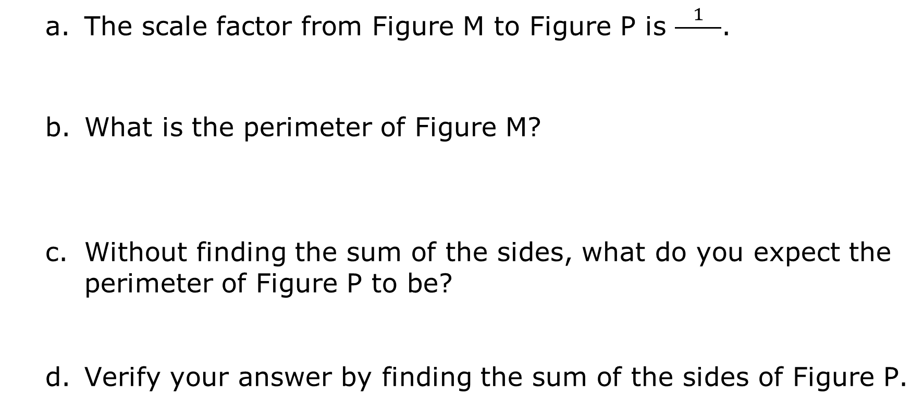
The scale factor from Figure M to Figure P is $\frac{1}{ }$.
What is the perimeter of Figure M?
Without finding the sum of the sides, what do you expect the perimeter of Figure P to be?
Verify your answer by finding the sum of the sides of Figure P.
volume 1, pg. 207

Slide 24
With your partner, write a rule that can be used to calculate the perimeter of a scale model if given only an original perimeter and a scale factor.
volume 1, pg. 207

Slide 25

Wrap-Up
volume 1, pg. 207

Slide 26
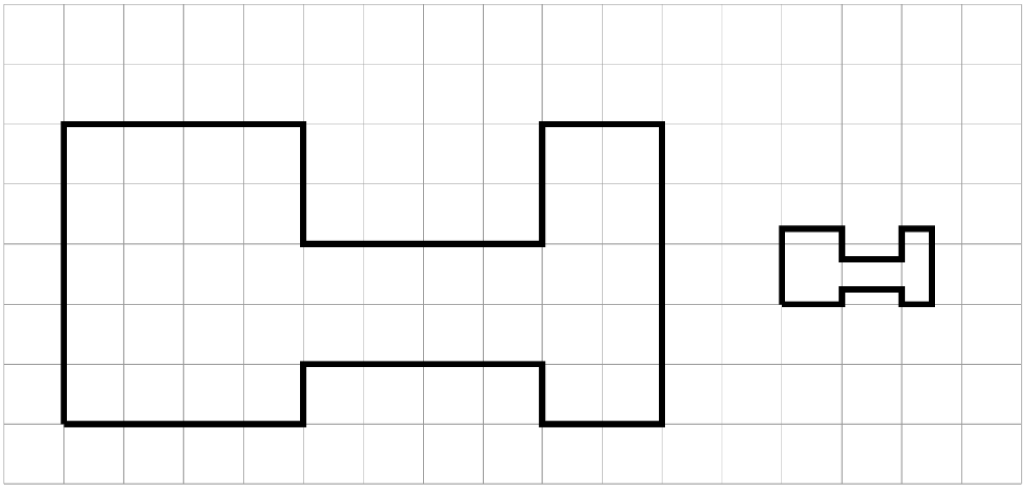
5.5.4 Wrap-Up: Ticket Out the Door
The second H-shaped polygon, Figure Y, is a scaled copy of the first, Figure X.
Figure X
Figure Y
volume 1, pg. 207

Slide 27
Show one pair of corresponding sides in the original polygon and its copy by drawing an arrow from Figure X to Figure Y.
What scale factor takes the original H-shaped polygon, Figure X, to its smaller copy, Figure Y?
What is the ratio of the perimeter of Figure Y to the perimeter of Figure X?
volume 1, pg. 207

